Slide 1
Simple-As-Possible (SAP-1) part 1

Slide 2
SAP-1
The Simple-As-Possible (SAP)-1 computer is a very basic model of a microprocessor explained.
The SAP-1 design contains the basic necessities for a functional Microprocessor.
Its primary purpose is to develop a basic understanding of how a microprocessor works, interacts with memory and other parts of the system like input and output.
The instruction set is very limited and is simple.
SAP is Simple-As-Possible Computer. The type of computer is specially designed for the academic purpose and nothing has to do with the commercial use.

Slide 3
SAP-1
The architecture is 8 bits and comprises of 16 X 8 memory. 16 memory locations with 8 bits in each location. All instructions (5 only) get stored in this memory. It means SAP cannot store program having more than 16 instructions.
SAP can only perform addition and subtraction and no logical operation. These arithmetic operations are performed by an adder/subtractor unit.

Slide 4
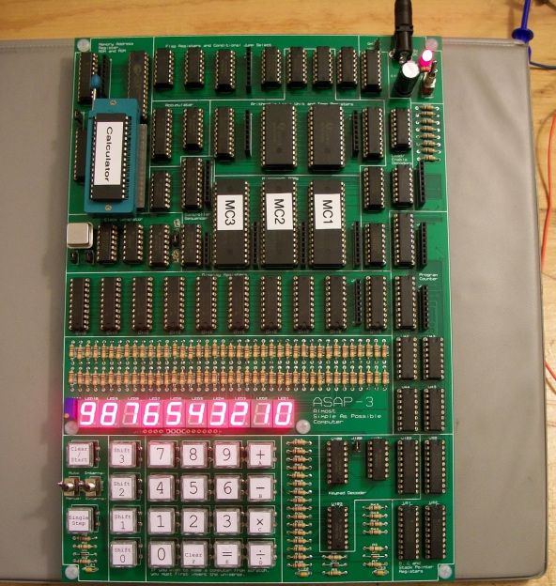

Slide 5
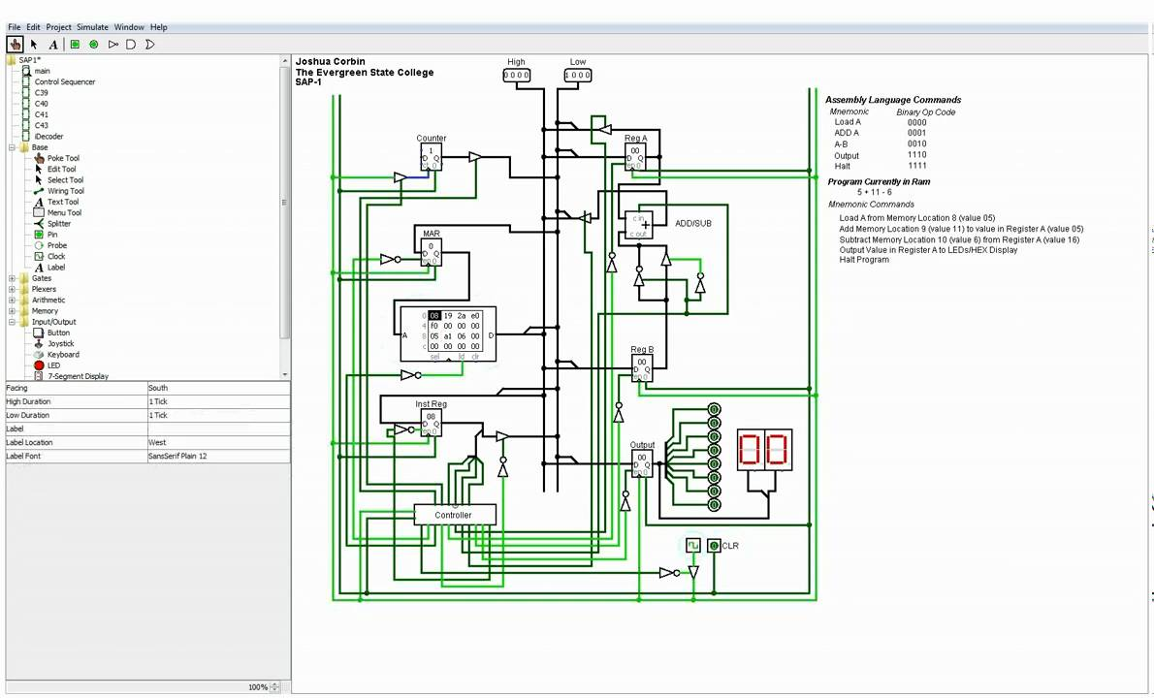

Slide 6
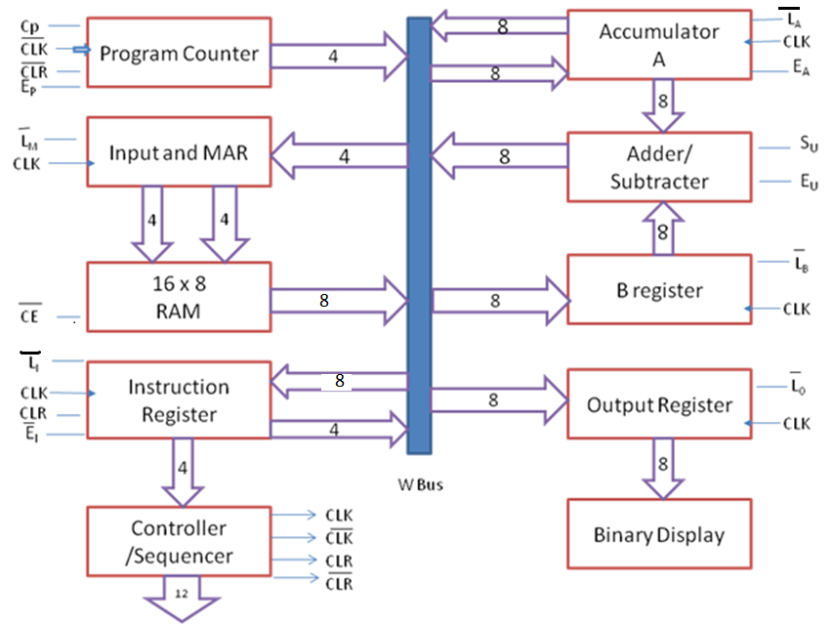
Block diagram of Simple-As-Possible (SAP)-1 Architecture
CON = C_{P} E_{P} L’_{M} CE’ L’_{I} E’_{I} L’_{A} E_{A} S_{U} E_{U} L’_{B} L’_{O}

Slide 7
SAP-1 Architecture
Counter Program (Program Counter)
Register Input & Memory Address Register (MAR)
16 x 8 RAM memory
Register Instructions
Control Sequencer (Control Sequencer)
Accumulator A
Adder / Substractor
Register B
Output Register
Binary display

Slide 8
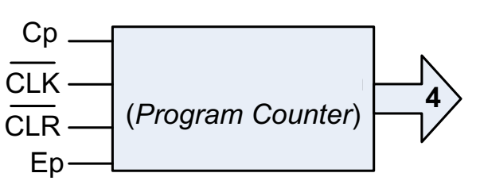
SAP-1 Architecture : 1. Program Counter
Function
Its job is to send to the memory address the memory address of the next instruction to be executed and fetched.
Control Line on Program Counter (PC):
- Ep: Transfer value from PC to Bus W
- Cp: Controls increment PC: PC PC + 1

Slide 9
SAP-1 Architecture : 1. Program Counter
Process
1) The PC is reset to 0000 before each computer run
2) When the computer run begins, the PC sends address 0000 to the MAR.
3) The pc is then incremented to get 0001.
MAR PC PC PC + 1
4) After the first instruction is fetched and executed, the PC sends address 0001 to the memory.
In this way, the PC is keeping track of the next instruction to be executed.

Slide 10
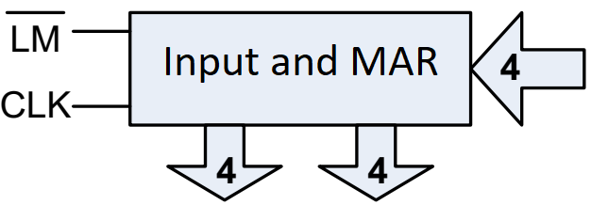
SAP-1 Architecture : 2. Input and MAR (Memory Address Register)
Function
Its job is to hold (latched) the address of PC into Memory Address Register (MAR)
Control Line on Input and MAR:
- Lm: Retrieving data from bus W into MAR.

Slide 11
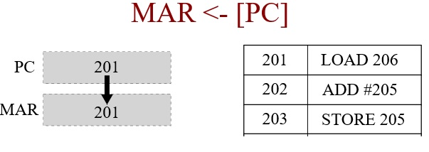
SAP-1 Architecture : 2. Input and MAR (Memory Address Register)

Slide 12
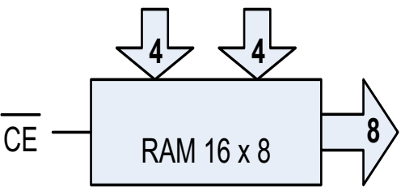
SAP-1 Architecture : 3. RAM
Function
The program code to be executed and data for SAP-1 computer is stored here.
Control Line on RAM:
- CE: Removing data 8 bit from memory to bus W.

Slide 13
SAP-1 Architecture : 3. RAM
Process
MAR applies 4-bit address to the RAM, where a real read operation is performed
Thus, the instruction or data word stored in RAM is placed on the W bus for use by some other part of the computer.

Slide 14
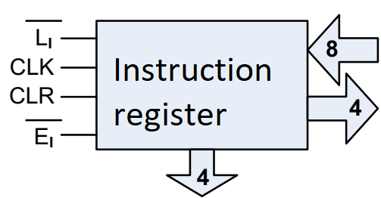
SAP-1 Architecture : 4. Instruction register
Function
IR contains the instruction (composed of OPCODE+ADDRESS) to be executed by SAP1 computer.
Control Line on Instruction register:
LI: Retrieve 8 bit data from bus W.
EI: Controls 4 bit data from IR to bus W.

Slide 15
SAP-1 Architecture : 4. Instruction register
Process
The contents of the IR are split into two nibbles.
The upper nibble is a two state output that goes directly to the block labelled ‘Controller-sequencer’.
The lower nibble is send to the W-bus.

Slide 16
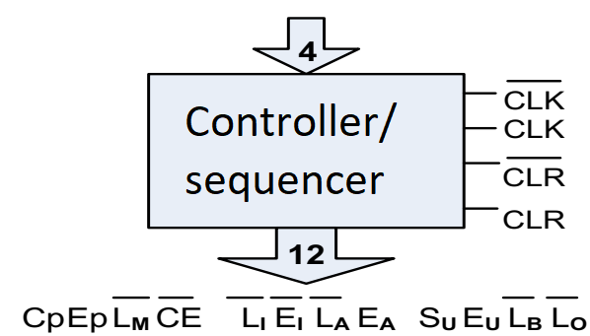
SAP-1 Architecture : 5. Controller/Sequences
Function
It generates the control signals for each block so that actions occur in desired sequence. CLK signal is used to synchronize the overall operation of the SAP1 computer.
A 12-bit word comes out of the Controller-Sequencer block. This control word determines how the registers will react to the next positive CLK edge.

Slide 17
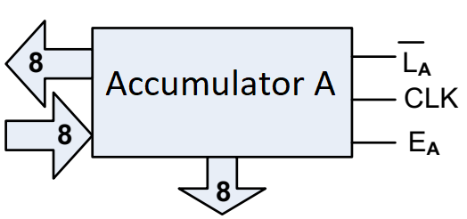
SAP-1 Architecture : 6. Accumulator A
Function
It is a 8-bit buffer register that stores intermediate results during a computer run.
It is always one of the operands of ADD, SUB and OUT instructions.
Control Line on Accumulator A:
La: Retrieve 8 bit data from bus W.
Ea: Control the 8 bit data into bus W (The value appeared in the W bus)

Slide 18
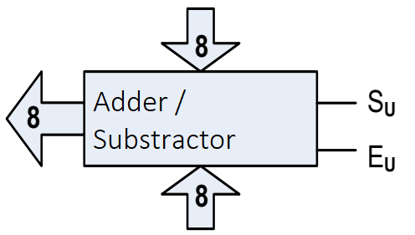
SAP-1 Architecture : 7. Adder / Substractor
Function
It is a 2's complement adder-subtractor.
Control Line on Adder / Substractor:
Su: Low signal (0) then addition operation, when signal high (1) then the operation substraction.
Eu: Send data to bus W

Slide 19
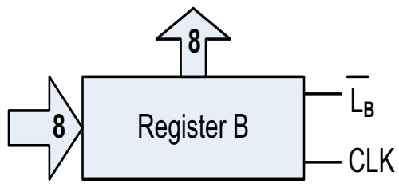
SAP-1 Architecture : 8. Register B
Function
It is 8-bit buffer register which is primarily used to hold the other operand (one operand is always accumulator) of mathematical operations.
Control Line on Register B:
Lb: Retrieve data from bus W to register B

Slide 20
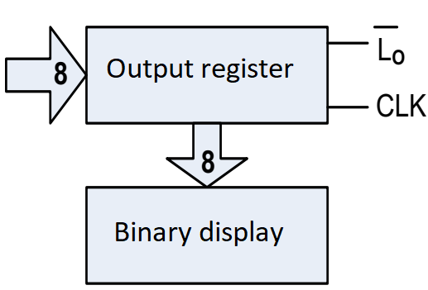
SAP-1 Architecture : 9. Output Register
Function
This registers hold the output of OUT instruction.
Control Line on Output Register:
Lo: Retrieve data 8 bits from bus W

Slide 21
SAP-1 Architecture : 10. Binary display
Function
It is a row of eight LEDs to show the contents of output register.
Binary display unit is the output device for the SAP-1 microprocessor.

Slide 22
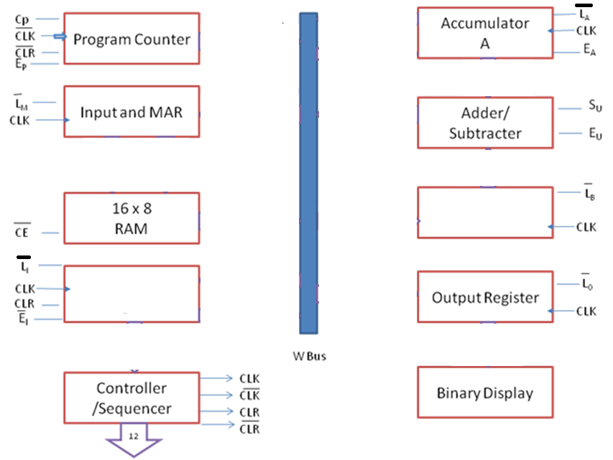
SAP-1 Architecture : Exercise

